Slide 1

From Prototype to Scale
How real AI products are built — and what it takes to go from a working demo to a system that handles thousands of requests reliably.
FORWARD DEPLOYED ENGINEERING · FINAL DEMO
Notes:
“Yesterday we built something interesting.
We created a prototype where a user could paste an email and our AI system would classify it and route it to the correct department.
That was great for proving the idea works.
But real companies don’t pay for ideas.
They pay for systems that can scale.
Today I want to show you how engineers think beyond prototypes.”

Slide 2



01 · RECAP
What We Built Yesterday
In our last session, we built a working AI prototype that takes a raw customer email, classifies its intent using a language model, and routes it to the correct department — all from a simple manual input.
Manual Input
AI Classification
Department Routing
Paste email text into the script
LLM identifies the intent category
Output directs to the right team
💳 Refund request
🔧 Tech issue
💼 Sales inquiry
→ Billing Team
→ Tech Support
→ Sales Team
Notes:
“Let’s quickly revisit what we built.
A user manually pasted:
* refund request
* technical issue
* sales inquiry
And our system routed it correctly.
This helped us validate:
Can AI understand customer intent?”

Slide 3

02 · FOUNDATIONS
Why Prototypes Matter
A prototype is not a toy — it is a strategic tool. Before investing in a full production system, a prototype lets you prove the idea works, gather real feedback, and reduce the risk of building the wrong thing.
1
Validate ideas quickly
Test the core hypothesis before writing production code
A validated prototype is the strongest argument for building the real product.
2
Test if AI works
Confirm the model performs well on real inputs
3
Get stakeholder feedback
Show something tangible to decision-makers early
4
Reduce development risk
Catch edge cases before they hit production
Notes:
“Many Engineers make a huge mistake.
They try to build large systems immediately.
That’s dangerous.
Prototype first:
* validate demand
* test technical feasibility
* gather stakeholder feedback
This saves months of wasted effort.”

Slide 4
03 · REALITY CHECK
Feedback We Might Receive
Real-world emails don't behave like test inputs. After sharing a prototype with stakeholders, these are the kinds of challenges that surface — and why they must be handled before any system goes live.
Multiple issues in one email
Vague or ambiguous emails
A customer asks about a refund and a technical error in the same message
"I have a problem with my account" — which team should handle this?
Attachments included
Low confidence predictions
Key context lives in a PDF or image, not the email body
The model isn't sure — should it guess or escalate?
Notes:
“Once stakeholders see the prototype, they start asking real questions.
What if:
One email contains both billing and technical issues?
What if attachments exist?
What if confidence is low?
These questions only emerge after prototypes.”

Slide 5

04 · RISK
Why Scaling Too Early Fails
Moving a prototype into production before it's ready doesn't save time — it creates compounding problems that erode customer trust and operational stability.
❌ Wrong routing
Emails land in the wrong inbox — no one acts
😤 Poor experience
Customers wait longer and receive irrelevant replies
⚙️ Operational mistakes
Teams are overwhelmed with misdirected work
💔 Loss of trust
Once broken, stakeholder confidence is hard to rebuild
Notes:
“Imagine automatically routing emails before testing edge cases.
A legal complaint gets routed incorrectly.
A refund request gets ignored.
That creates customer frustration.
Scale bad systems → bigger disasters.”

Slide 6
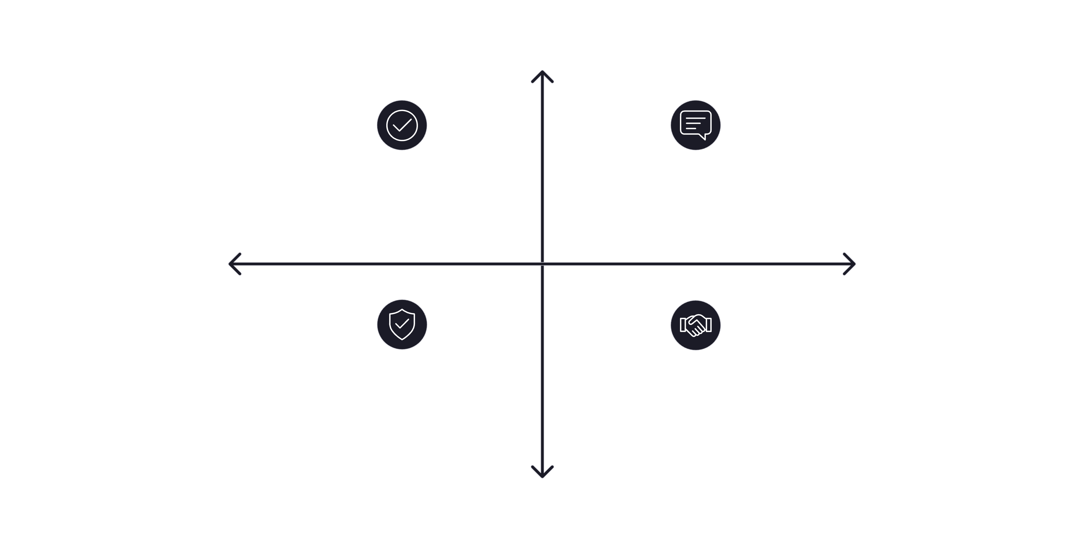

05 · READINESS
When We Scale
Scaling is not a date on a calendar — it's a standard. A system earns the right to scale when it has passed every gate below.
High Confidence
Prototype validated — core logic works
Feedback collected from real users
Stakeholder Alignment
Operational Readiness
Edge cases handled and tested
Business approves stakeholder sign‑off
Low Risk
Each gate is a quality checkpoint. Skipping any one of them increases the probability of failure in production.
Notes:
“We scale only when:
The prototype works
Feedback is collected
Edge cases are handled
Business teams approve”

Slide 7


06 · VALUE
What Companies Actually Want
Prototype
Scale
Proves the concept is viable
Delivers continuous business value
Validates AI accuracy
Generates stakeholder buy-in
Exposes gaps before they cost money
Runs automatically, 24/7
Handles thousands of emails
Reduces headcount costs
Used for decisions
Used for operations
The prototype earns the meeting. The scaled system earns the contract.
Notes:
“This is where value changes.
Prototype = proof
Scale = money
That’s when businesses become interested.”

Slide 8
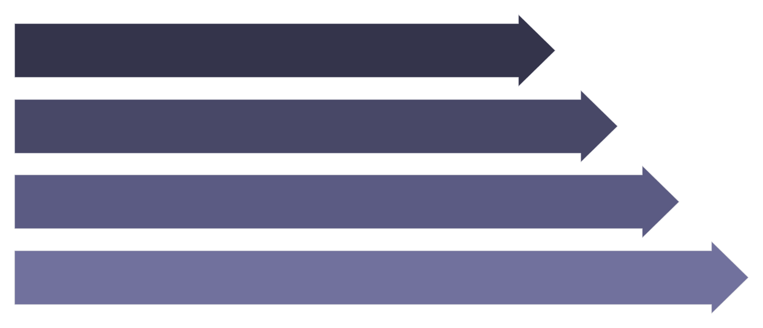
07 · ARCHITECTURE
Scalable Workflow
A production-ready email classification system replaces every manual step. No human touches the inbox — the pipeline runs continuously and autonomously.
Inbox Arrival
Auto Read API
LLM Intent
Route to Dept
Every stage is automated, logged, and recoverable — meaning if something fails, the system can retry without losing data.
Notes:
Once we Scale the solution.
Now no employee manually copies emails.
System automatically:
reads
classifies
routes
This becomes operational infrastructure.”

Slide 9
08 · IMPACT
Business Value
Faster Responses
Lower Costs
Emails are classified and routed in seconds — not hours. SLA compliance improves dramatically.
Automation eliminates repetitive manual triage work, freeing staff for higher-value tasks.
Less Manual Work
Better Experience
No one reads and sorts emails by hand. The system handles classification end-to-end.
Customers reach the right team faster, reducing friction and increasing satisfaction scores.
Notes:
“Why would companies pay?
Lower operational cost
Faster support
Better customer experience
Reduced manual labor”

Slide 10
09 · MINDSET
Think Like an FDE
A Forward Deployed Engineer doesn't just write code — they think through the entire system before writing a single line. Ask these four questions before building anything.
1
2
Where do emails come from?
How are emails read?
Gmail? Outlook? A helpdesk API? The source determines your ingestion method.
IMAP polling? Webhook? Real-time or batch? Defines your system's responsiveness.
3
4
How does classification happen?
How does routing happen?
Which model? What prompt? How do you handle low-confidence outputs?
SMTP forwarding? CRM update? Ticketing system? Defines the integration layer.
Notes:
“This is where engineering thinking begins.
Ask:
Where does data come from?
How do we process it?
How does output reach users?”

Slide 11
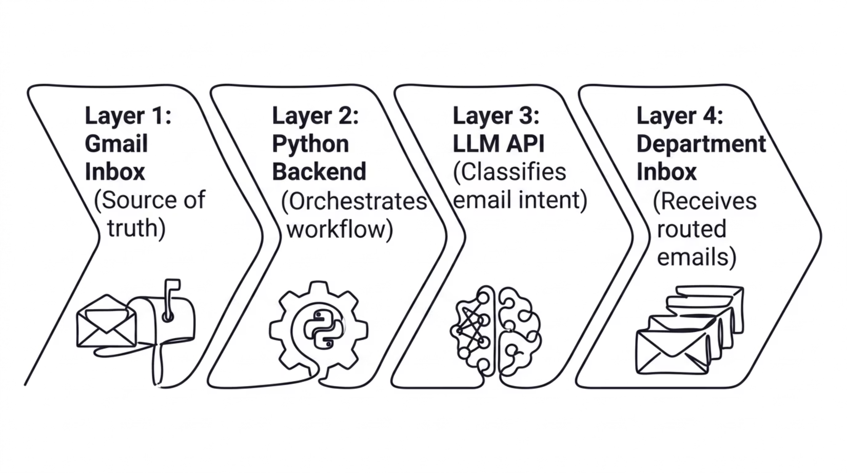

10 · ARCHITECTURE
System Architecture
Every component in this pipeline has a specific responsibility. Understanding how they connect is the difference between writing code and designing a system.
Notes:
“Notice this isn’t just AI.
We need:
email infrastructure
backend logic
AI layer
routing layer”

Slide 12
11 · STACK
Technology Stack
This system is built with four tools that every FDE should know. Together, they cover ingestion, orchestration, intelligence, and delivery.
Python
Gmail API / IMAP
Core backend language — orchestrates the entire pipeline
Reads unread emails from the inbox automatically
OpenAI / Gemini
SMTP
Classifies email intent using a large language model
Delivers routed emails to the correct department inbox
Notes:
Nothing magical.
Python
APIs
LLMs
SMTP
Simple tools combined correctly.”

Slide 13
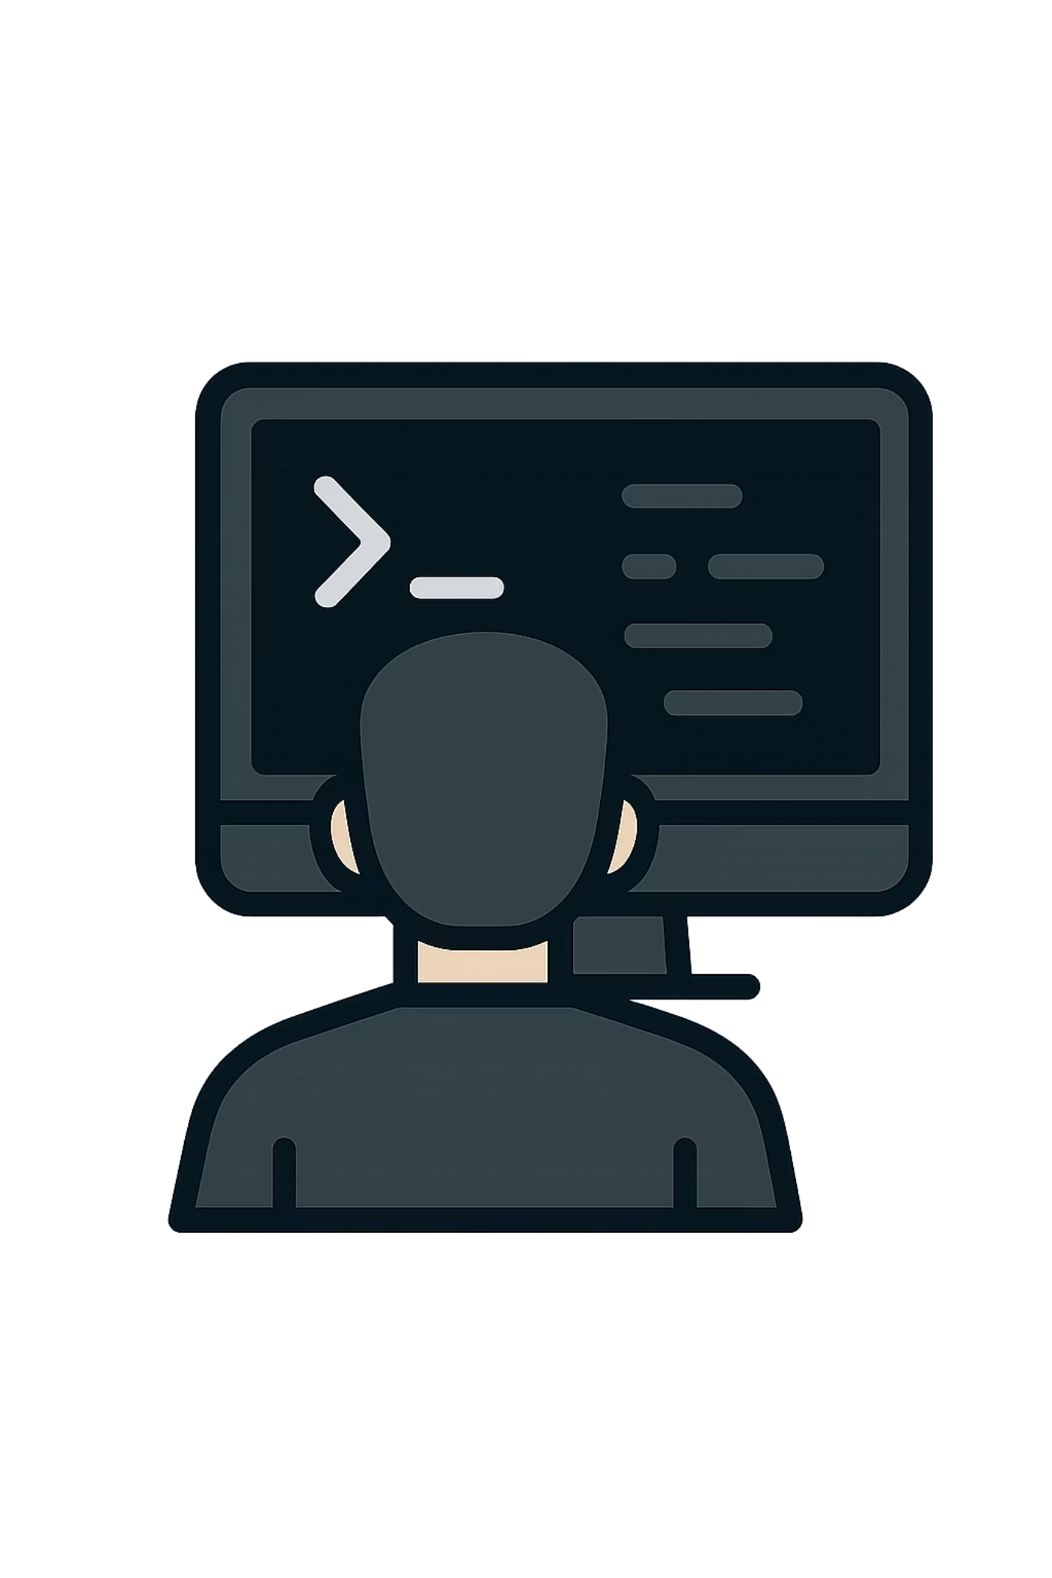
12 · DEMO
Live Workshop Demo
Over to VS Code
01
Read unread emails
02
Extract content
03
Classify with AI
04
Route automatically
Notes:
“Let me show you how quickly this becomes real.”
(Dont start slides yet)

Slide 14


STEP 1
Read Emails
The first step is connecting to the Gmail inbox using IMAP and fetching all unread messages. The script authenticates with the mail server, selects the inbox, and retrieves only the messages the system hasn't processed yet — avoiding duplicates and reprocessing.
The system marks each email as "read" after processing to ensure it isn't classified twice.
Authenticate via IMAP or Gmail API
Fetch only unread messages
Extract raw email data into memory
Notes:
Step 1 Read Emails
“We fetch unread emails directly from Gmail.”

Slide 15
STEP 2
Extract Content
Before classification, the system must parse the raw email into clean, structured fields. The language model will only receive the information it needs — no noise, no headers, no metadata bloat.
📧 Sender
📝 Subject
📄 Body
Who sent the email — used for logging and reply routing
Often contains the clearest signal for classification
The full message text — primary input to the LLM prompt
Clean inputs produce clean classifications. Garbage in, garbage out — this step is critical.
Notes:
“We extract:
subject
body
sender
This becomes AI input.”

Slide 16


STEP 3
AI Classification
The extracted email content is passed to the language model with a structured prompt. The model returns a single category label. The system uses that label to determine the routing destination.
Refund Request
→ Billing Team
Keywords: refund, charge, money back
Handles all payment and refund issues
Tech Issue
→ Tech Support
Keywords: error, broken, not working
Handles bugs, outages, and feature errors
Sales Inquiry
→ Sales Team
Keywords: pricing, demo, upgrade, plan
Handles all commercial conversations
Notes:
“This is where LLMs shine.
Understanding messy natural language.”
This might be the only AI factor in this entire project.

Slide 17


STEP 4
Route Emails
Once the category is known, the system uses SMTP or Gmail API to forward the original email — along with classification metadata — to the correct department inbox. No human decides. No manual copy-paste. The right team simply receives the right email.
Send email automatically via SMTP
Include classification label in subject
Correct department receives it instantly
Original sender data preserved
Routing takes milliseconds — not minutes or hours.
Notes:
“Once classified:
system routes to specific departments automatically.”
Send email automatically
Include classification label in subject
Correct department receives it instantly
Original sender data preserved

Slide 18
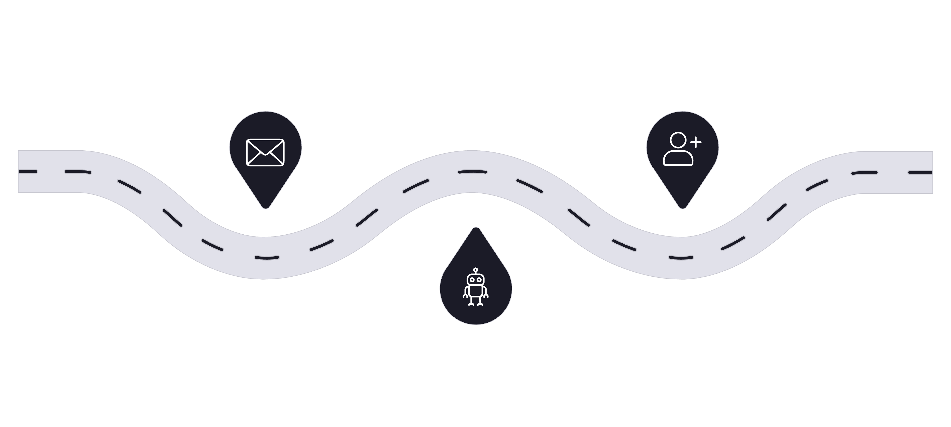
13 · RESULT
Final Product
This is what a working, automated AI system looks like end-to-end. No human touches the pipeline. The customer gets faster service. The business saves time and money.
Incoming Email
Team Action
Customer message lands in Gmail
Correct department receives and acts
Automated Routing
Python + LLM classifies and routes
This is not a demo anymore — this is a deployable system.
Notes:
“This is no longer a classroom project.
This is something businesses can deploy.”

Slide 19
14 · SCALE
Imagine Scale
50K
Massive operational savings
Faster support teams
Agents only see emails already matched to their expertise — no triage overhead
What once required a team of agents now runs on a few hundred lines of Python
emails processed monthly — automatically, with no additional headcount
24/7 availability
The system never sleeps, takes breaks, or misclassifies due to fatigue
Notes:
“What happens at:
50,000 emails/month?
Huge savings.”

Slide 20


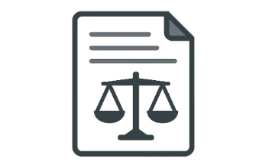
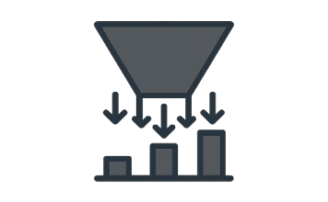
15 · TRANSFERABILITY
Reuse This Architecture
The pattern you built today — ingest, classify, route — is one of the most reusable patterns in enterprise AI. Swap the data source and the categories, and you have a new product.
Resume Routing
Insurance Claims
Legal Documents
Lead Routing
Classify candidates by role and route to the right hiring manager automatically
Triage incoming claims by type — auto, medical, home — before a human reviews
Classify contracts and filings by category and assign to the correct legal team
Score and route inbound sales leads to the right rep based on intent signals
Notes:
“This same architecture applies everywhere:
insurance
HR
legal
sales”
## NOW GO TO DEMO AND CODE

Slide 21
16 · WHAT'S NEXT
Course Roadmap
Today's session is one milestone in a complete FDE curriculum. Each module builds on the last — from core thinking, to AI-powered APIs, to deployed products.
Problem Solving
1
Think like an engineer — break problems into solvable pieces
2
Python
Build backend logic and connect systems programmatically
APIs & AI
3
Integrate LLMs, external services, and data sources
4
RAG Systems
Ground AI in real company data using retrieval techniques
UI & Deployment
5
Ship a real interface and deploy to production infrastructure
Notes:
“Today you saw pieces from multiple modules.
This course teaches every layer step by step.”

Slide 22

17 · FINAL MESSAGE
Final Message
Most people learn tools. Few people build products. The world needs builders.
🎓 Most learn tools
🏗️ Few build products
🚀 Become a builder
They follow tutorials and copy examples without understanding the system
They connect the pieces, handle edge cases, and ship something real
That is what this course trains you to do — and what companies pay for
Notes:
I want to leave you with one thought.
Most people today are learning isolated tools.
They know:
LangChain
OpenAI
FastAPI
ML models
But they cannot combine them into real products.
Companies increasingly need builders.

